Slide 1

G M University, Davanagere.
Department of CS-Cyber Security &
CS-Information Security
A Project Presentation on
“Health Monitoring System”
Presented By:
Kulkarni Atharva U24E01IY036
Naveen D U24E01IY040
Nikhil Suthar U24E01IY043
Pavan Kumar V M U24E01CY095
Ujjwal Kumar U24E01IY076
Project Guide:
Mrs . Nayana M R
Assistant Professor
Project Coordinator:
Mrs. Nayana M R
Assistant Professor
Head of the Department: Dr. Aruna Kumar B T
Assistant Professor

Slide 2






Guide Name : Nayana M R
TEAM-MATES
Photo
Photo
Photo
Photo
Naveen N D Kulkarni Atharva
Ujjwal Kumar Pawan Kumar
Nikhil Suthar

Slide 3

CONTENTS
01
INTRODUCTION & Overview
02
Acquisition
03
Cleaning
04
Protocols
05
Validation
06
Performance

Slide 4

Project Overview & Goals
Review 2 Focus Areas
Project Introduction
The focus of Review 2 includes sensor accuracy, data handling efficiency, protocol evaluation, and performance metrics to ensure system reliability.
This project aims to develop a real-time health monitoring system using IoT sensors to track temperature and heart rate (BPM).
Key Deliverable
The key deliverable is a functional health dashboard that provides real-time data analysis and insights for continuous health monitoring.

Slide 5
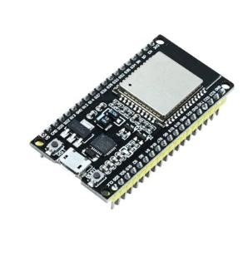
Components Used :
Required Components
1.ESP32 Board (ESP32-WROOM-32) • Built-in Wi-Fi, ADC, I²C support • Easy programming (Arduino / ESP-IDF)
2.Temperature & Humidity Sensor (DHT11 / DHT22) • Measures temperature and humidity
3.DHT22 recommended
for higher accuracy
4.Heart Rate / SpO₂ Sensor (Choose one) • MAX30102 – Heart rate + SpO₂ (I²C based) • Pulse Sensor Amped – Heartbeat only (Analog)
5.Jumper Wires (M–M, M–F) • Used for sensor connections
ESP32

Slide 6
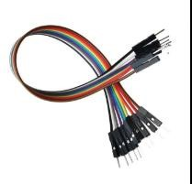
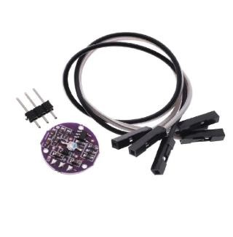
6.Breadboard (Optional) • Helps in neat and easy prototyping
7.USB Cable • Programming and power supply
Jumper wires
Analog pulse sensor wired to ADC pin

Slide 7
Sensor Data Acquisition
Sensors Used
01
The system uses DHT22 for temperature (±0.5°C) and MAX30102 for heart rate (±5 BPM) to ensure accurate health monitoring.
Data Preprocessing
02
Data undergoes digital filtering, outlier detection, and moving average smoothing to ensure high-quality, noise-free readings for reliable analysis.

Slide 8
Data Structuring & Cleaning
Noise Removal
Normalization
Data Organization
Error Handling
Median filtering is applied to eliminate sensor spikes and erratic readings, ensuring clean data for analysis.
Data is normalized to a 0-100 scale for consistent analysis across different sensors and metrics.
Data is organized in JSON/CSV format with timestamp, sensor ID, and value fields for efficient storage and querying.
The system includes null value detection, failed reading management, and automatic retries to handle data acquisition errors.

Slide 9

Communication Protocols Evaluated
Protocol Selection
MQTT was selected for its low-bandwidth, pub-sub efficiency, ensuring reliable and efficient data transmission from sensors to the dashboard.

Slide 10

Result Interpretation & Validation
Dashboard Accuracy
01
The dashboard accurately visualizes time-series graphs, showing consistent and reliable data for real-time health monitoring.
Sensor Trends
Temperature remains stable between 96.6-97.2°C, and BPM ranges from 60-80 bpm, aligning with normal physiological patterns.
Consistency Check
02
Multiple readings were validated, confirming no major discrepancies and ensuring data integrity and accuracy.

Slide 11
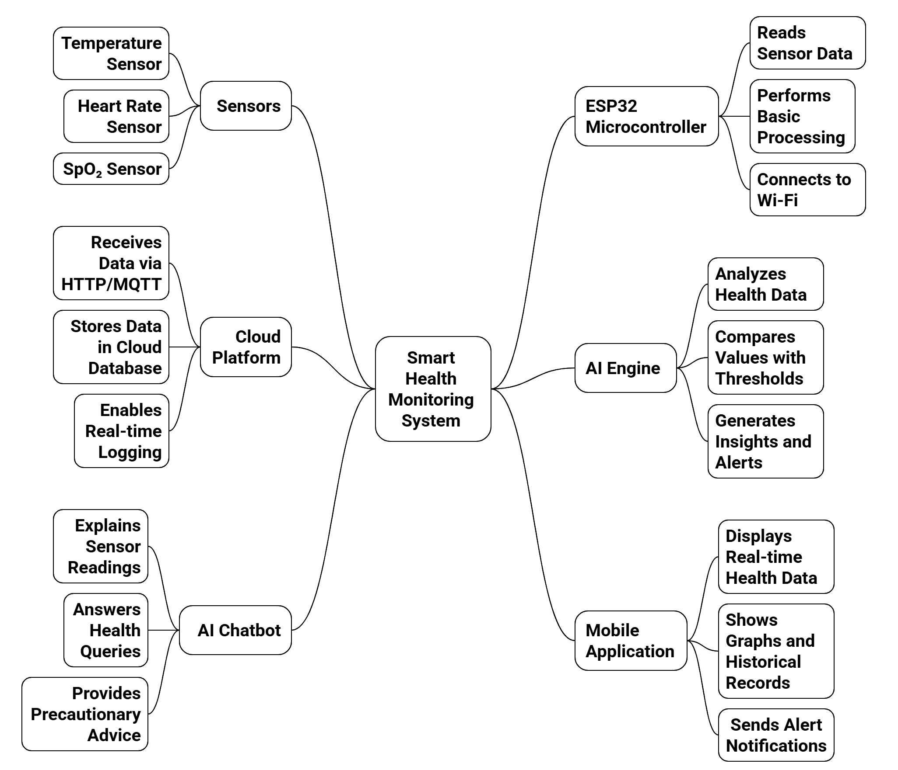
Flowchart :

Slide 12
System Performance Metrics
The dashboard updates within less than 30 seconds of sensor readings, ensuring real-time monitoring and quick response.
The system achieves 99.8% uptime with less than 0.2% data loss, demonstrating high reliability and minimal downtime.
Response Time
Data Reliability

Slide 13
System Reflection & Improvements
Strengths
Proposed Improvements
The system excels in robust sensor integration, accurate real-time visualization, and a reliable data pipeline for continuous monitoring.
Future improvements involve machine learning for anomaly detection, multi-sensor fusion, edge computing, mobile app development, and enhanced data encryption.
Challenges
Compliance
Challenges include sensor calibration drift, WiFi latency, and cloud-edge synchronization delays that affect performance.
Enhanced data encryption will be implemented to ensure HIPAA compliance and protect user privacy in healthcare applications.

Slide 14

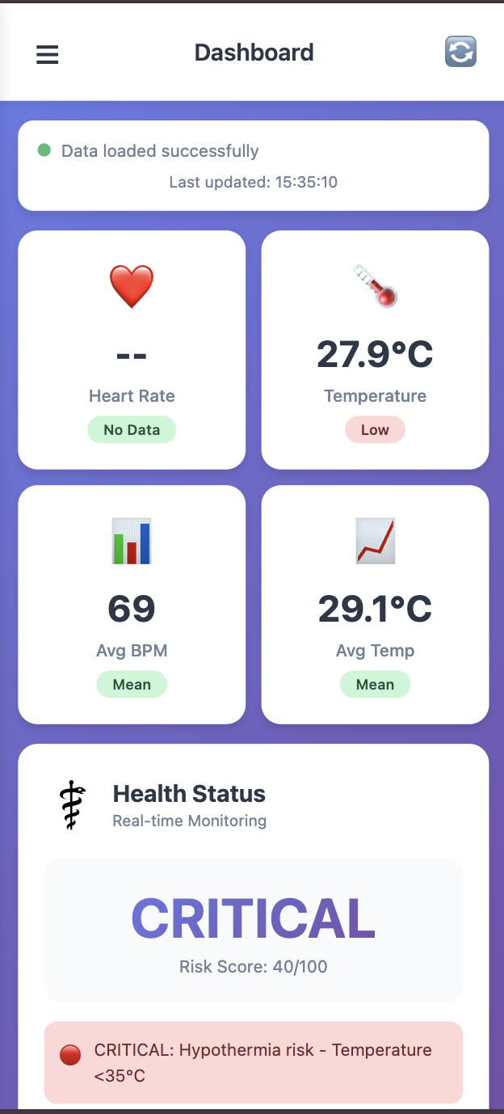
Dashboard Screenshots

Slide 15
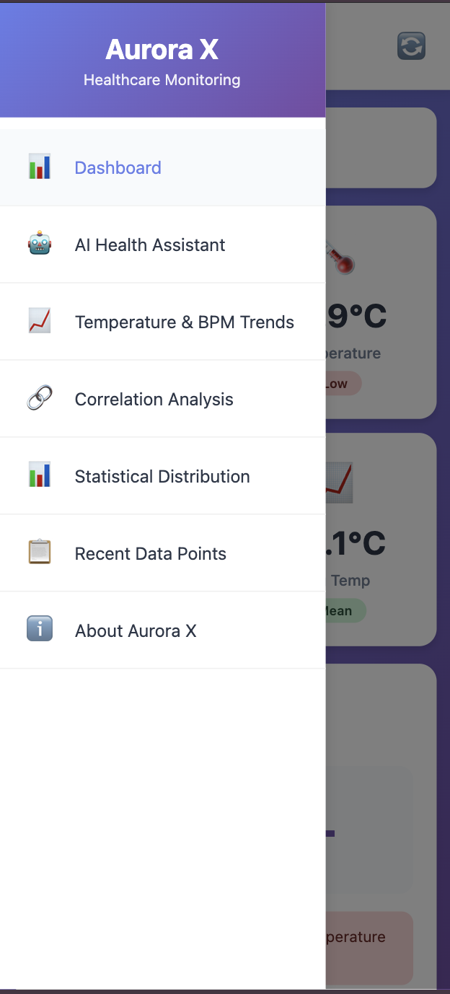
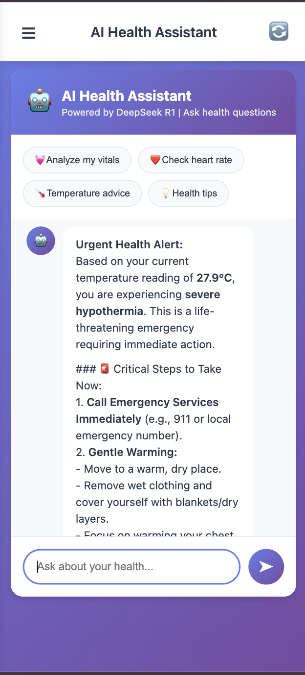
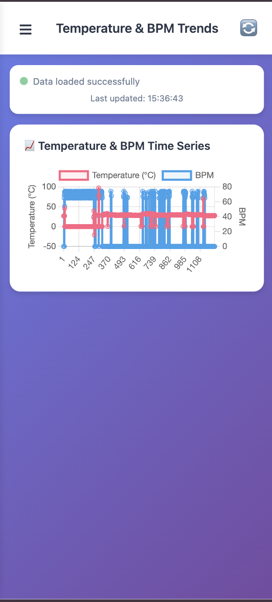
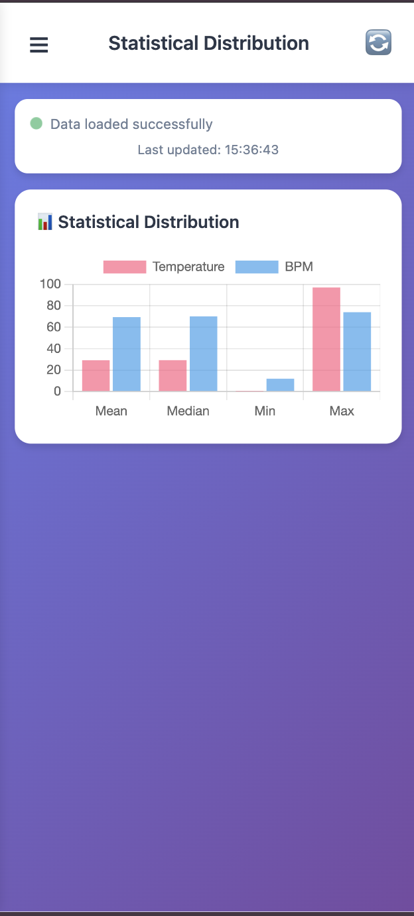
AI-Health Assistents

Slide 16
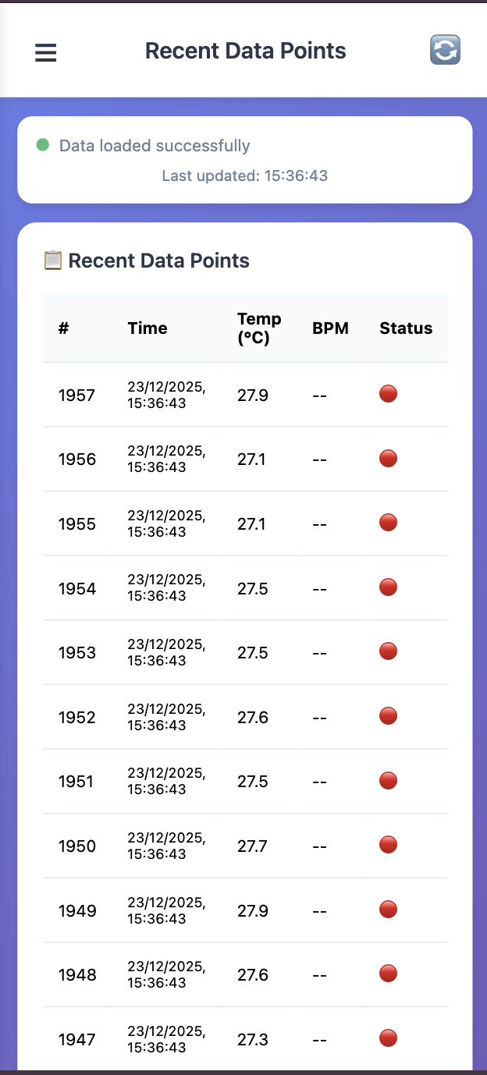
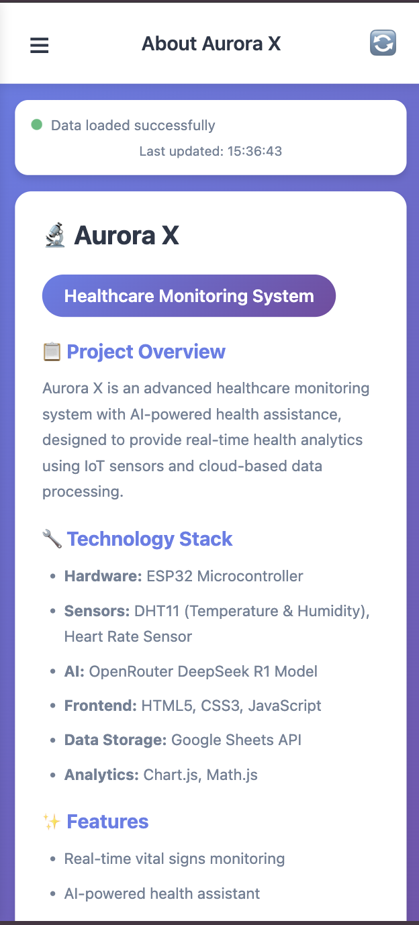
Temperature & BPM Time Series Analysis

Slide 17
Statistical Distribution Comparison

Slide 18
Conclusion & Next Steps
Review 3 Goals
The Health Monitoring System successfully enables continuous tracking of vital health parameters, improving early detection of health issues. It provides accurate, real-time data that supports timely medical decisions and better patient care. The system is user-friendly, cost-effective, and suitable for both personal and clinical use. Overall, it enhances healthcare efficiency and promotes proactive health management.
Project Conclusion
Thank You

Slide 19

THANK YOU

